Slide 1
What is an Operation and Misoperation
James Hanson, WECC
Rich Quest, MRO
Rich Bauer, NERC

Slide 2
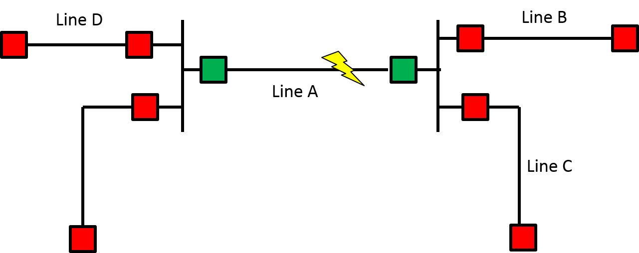
Example 1
A permanent fault occurs on Line A. Both ends trip and reclose (two attempts) to lockout. How many operations and misoperations should be reported?

Slide 3
Example 1 – Survey Results

Slide 4
Example 1 - Reason
When reclosing is applied (automatic or manual), a sequence of reclosing and tripping associated with isolating a faulted system Element is counted as a single operation. Multiple unintended operations of an Element due to this sequence of reclosing and tripping would also be counted as a single operation.
Reference: MIDAS Reporting Template – Definition of Protection System Operation

Slide 5
Example 2
A permanent fault occurs on Line D. The Line D breakers trips, but a breaker on Line E overreaches and trips incorrectly. How many operations and misoperations should be reported?
Line D
Line B
Line A
Line E
Line C

Slide 6
Example 2 - Poll
Two operations, one misoperation
No operation, one misoperation
One operation, one misoperation
None of the above

Slide 7
Example 2 - Answer
Correct Answer:
Two operations, one misoperation

Slide 8
Example 3
A breaker on Line D trips due to a failed relay with no fault. How many operations and misoperations should be reported?
Line D
Line E

Slide 9
Example 3 - Poll
No operation, one misoperation
One operation, no misoperation
One operation, one misoperation
None of the above

Slide 10
Example 3 - Answer
Correct Answer:
One operation, one misoperation
Reason:
No misOPERATION without an OPERATION

Slide 11
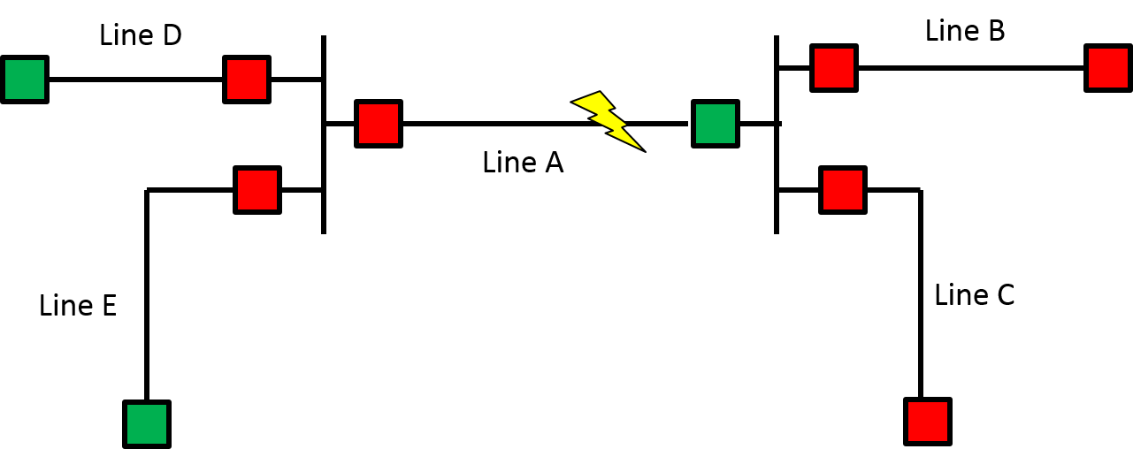
Example 4
A fault occurs on Line A. The left terminal breaker fails to trip. The remote ends of Line D and E trip. In this case, the left terminal breaker does not have breaker failure protection. How many operations and misoperations should be reported?

Slide 12
Example 4 - Poll
Three operations, one misoperation
Two operations, one misoperation
Three operations, no misoperation
None of the above

Slide 13
Example 4 - Answer
Correct Answer:
Three operations

Slide 14
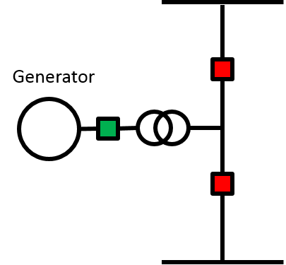
Example 5
During scheduled maintenance a relay operates. How many operations and misoperations should be reported?

Slide 15
Example 5 - Poll
No operation, no misoperation
One operation, one misoperation
One operation, no misoperation
None of the above

Slide 16
Example 5 - Answer
Correct Answer:
No operation, no misoperation

Slide 17
Example 6
A fault occurs on Line A. The left terminal breaker fails to trip. The remote ends of Line D and E trip. In this case, the left terminal breaker has breaker failure protection. How many operations and misoperations should be reported?

Slide 18
Example 6 - Poll
Three operations, one misoperation
Two operations, one misoperation
Three operations, no misoperation
None of the above

Slide 19
Example 6 - Answer
Correct Answer:
Three operations, one misoperation

Slide 20
Example 7
XYZ end of ABC - XYZ 345kV line tripped and reclosed.
The misoperation occurred again at 12:27, 13:08, and 13:44.
Tripping was due to a misoperating transfer trip receiver.
How many operations and misoperations should be reported.

Slide 21
Example 7 - Poll
Three operations, three misoperations
One operation, one misoperations
No operation, one misoperation
Three operations, one misoperation

Slide 22
Example 7 - Answer
Correct Answer:
One operation, one misoperation

Slide 23
Example 8
Entity 1 and Entity 2 jointly own Line A.
A permanent fault occurs on Line A. Both ends trip and reclose (two attempts) to lockout.
One operation and no misoperation should be reported.
Who should report?

Slide 24
Example 8 - Poll
Both entities report. The report includes no notes about joint ownership.
The entities communicate and both entities report. The reports include notes that Line A is jointly owned and that both entities are reporting.
The entities communicate and decide only one entity will report.

Slide 25
Example 8 - Answer
Correct Answer:
The entities communicate and decide only one entity will report.

